Slide 1
AUTOMATIC SMART DUSTBIN

Slide 2
AUTOMATIC SMART DUSTBIN USING ARDUINO
INTRODUCTION:
The main objective of the project is to keep our environment clean and eco friendly by designing a smart dustbin
Used to collect and reduce waste efficiently
The whole process will allow workers to route pick up systematically on every filled up and keep the environment clean and hygiene
This smart dustbin is built on the microcontroller based system having ultrasonic sensors

Slide 3
COMPONENTS:
Arduino UNO:
Arduino UNO is a microcontroller board based on the ATmega328P. It has 14 digital input/output pins (of which 6 can be used as PWM outputs), 6 inputs, a 16 MHz ceramic resonator, a USB connection, a power jack, an ICSP header and a reset button. It contains everything needed to support the microcontroller; simply connect it to a computer with a USB cable or power it with a AC-to-DC adapter or battery to get started.
Ultrasonic sensor:
Ultrasonic sensors work by sending out a sound wave at a frequency above the range of human hearing. The transducer of the sensor acts as a microphone to receive and send the ultrasonic sound. Ultra sonic sensors use a single transducer to send a pulse and to receive the echo. The sensor determines the distance to a target by measuring time lapses between the sending and receiving of the ultrasonic pulse

Slide 4
Servo motor:
A servo motor is an electrical device which can push or rotate an object with great precision. If you want to rotate an object at some specific angles or distance, then you use servo motor. It is just made up of simple motor which run through servo mechanism. If motor is used is DC powered then it is called DC servo motor, and if it is AC powered motor then it is called AC servo motor.

Slide 5
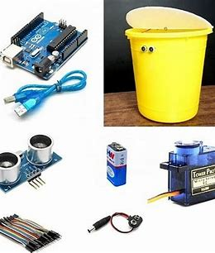
Dustbin
Jumper Wires
Adapter

Slide 6
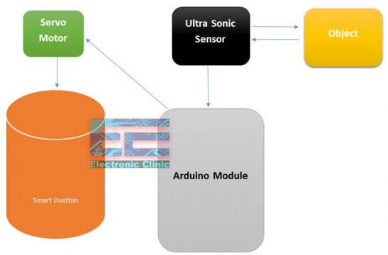
BLOCK DIAGRAM:

Slide 7
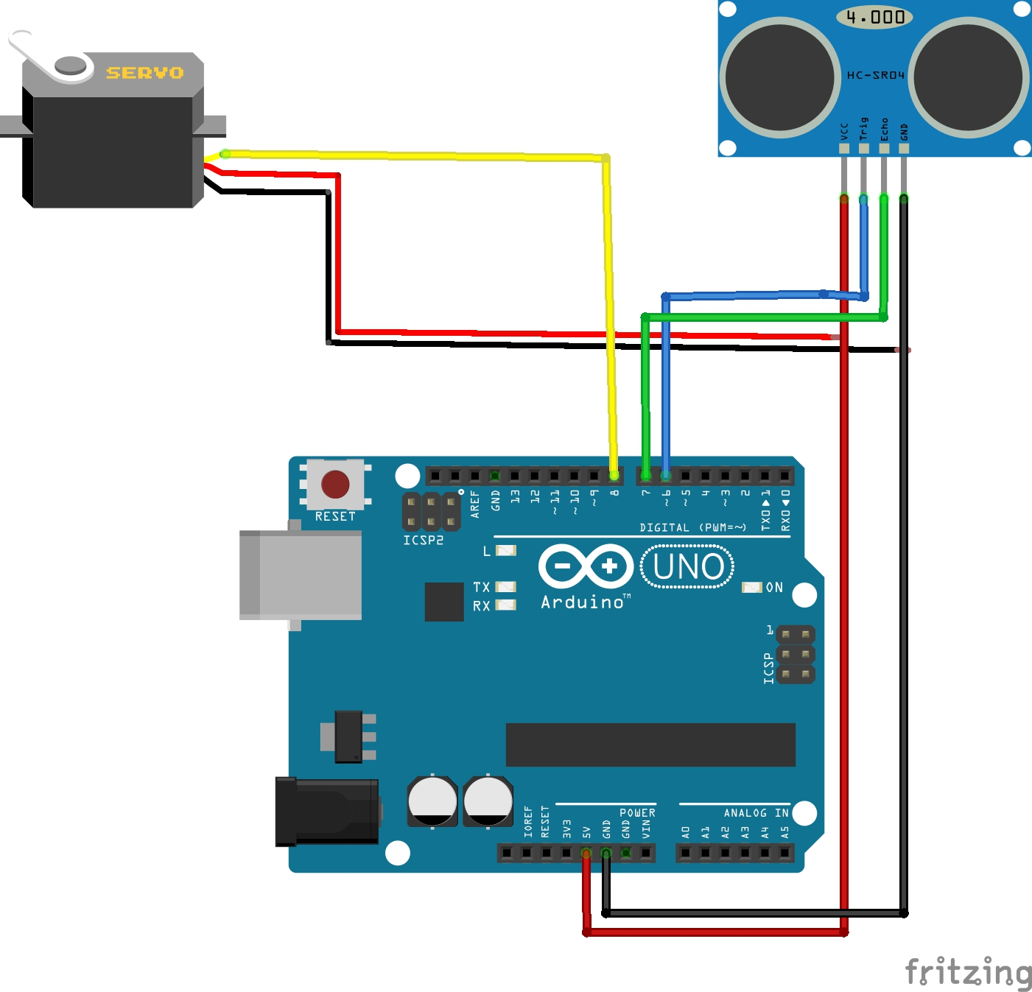
CIRCUIT DIAGRAM:

Slide 8
Working:
The smart dustbin uses an Ultrasonic sensor to detect objects in front.
It then sends the signals to Arduino Uno. The Arduino understands the signal and sends a signal to the Servomotor which opens the flap on top of the dustbin.
Here we have programmed it to open the flap for only 8 seconds after 8 seconds the flap automatically closes. You can change that time just by making minor changes to the code in Arduino uno.
Lid will open for a given time and then it will close automatically

Slide 10
ARDUINO CODE :
#include <Servo.h> //servo library
int IRsensor = 7; // connect ir sensor to arduino digital 7 pin
Servo myservo; //create servo object
int pos=0; //set the default position to zero
void setup()
{
Serial.begin(9600);
pinMode (IRsensor, INPUT); // sensor pin INPUT
myservo.attach(9);
myservo.write(0); //close cap on power on
delay(100);
}
void loop()
{
int value = digitalRead (IRsensor);
if (value == 1)
{ Serial.print("HIGH- Opening the lid of bin\n");
myservo.write(90);
delay(8000);
}
else
{ Serial.print("LOW- lid remains close\n");
myservo.write(0);
delay(3000);
}
}

Slide 11
ADVANTAGES:
The smart bin reduces our efforts and time
Truck collection visits enhance traffic and jamming , the smart trash container interrupts traffic and makes the street even cleaner
Few smart bins come with a WiFi facility increase in hotspot coverage for the public
This smart move improves street hygiene and safety
They also encourage recycling and reusability

Slide 12
CONCLUSION:
Here we are going to make an evolution changes toward cleanliness. The combination of intelligent waste monitoring and trash compaction technologies, smart dustbins are better.
For social it will help toward health and hygiene, for business we try to make it affordable to many as many possible. So that normal people to rich people can take benefit from it.
So our next work will be adding one more sensor which will sense whether our dustbin is full or not. This will bring something changes in term of cleanliness as well technology

Slide 13
THANK YOU

